Slide 1

Insurance Performance Dashboard
A comprehensive review of policy sales, premium collection, and claims processing performance across all product lines and advisor channels.

Slide 2

Executive Summary: Key Metrics at a Glance
400
$1.13M
95
$16.45M
Policies Sold
Premium Collected
Total Claims
Claims Requested
Total contracts issued
Total revenue generated
Claims filed and processed
Total amount claimed
$7.32M
Claims Processed
Amount approved and paid
Critical Insight: Claims requested significantly exceed processed claims ($16.45M vs $7.32M), indicating potential claims backlog or strict approval controls requiring immediate attention.

Slide 3
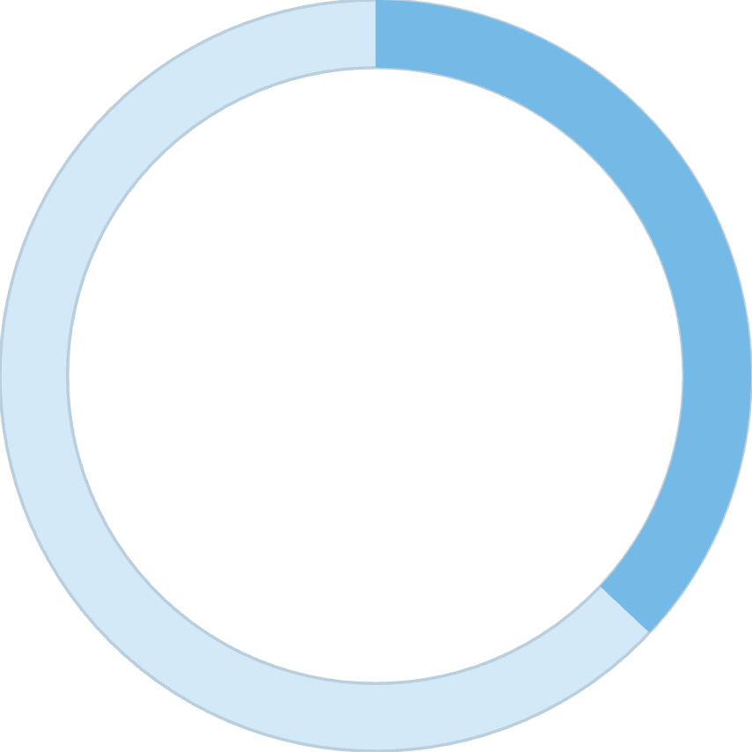
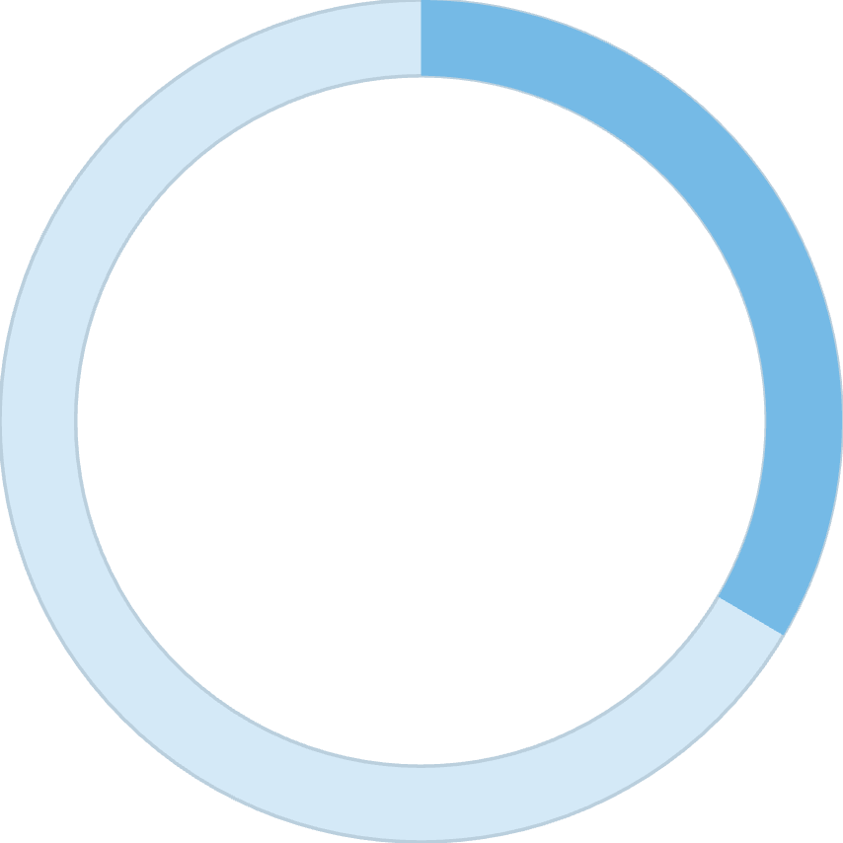
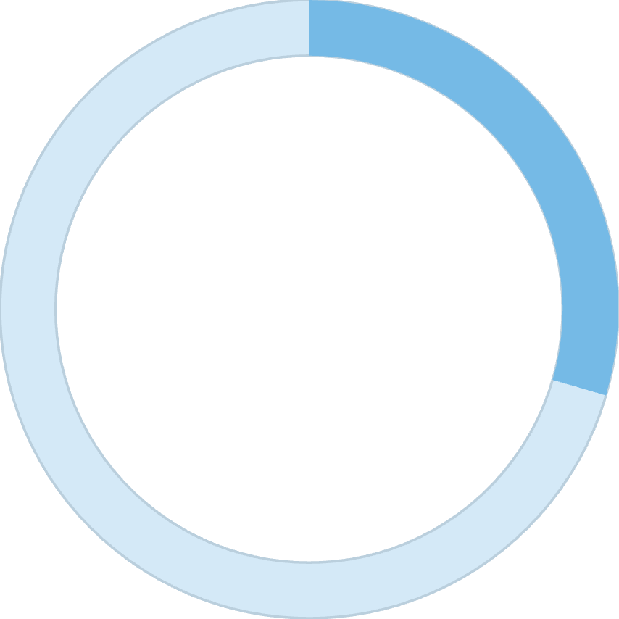
Policy Mix Analysis: Diversified Portfolio
37%
33.5%
29.5%
Whole Life
Term Life
ULIP
Permanent coverage with cash value accumulation
Pure protection for specific time periods
Investment-linked products with dual benefits
Our portfolio demonstrates strong diversification across policy types, with slight dominance of Whole Life policies. This balanced risk distribution protects against concentration in any single product line.

Slide 4

Premium Contribution Analysis: Revenue Drivers
Revenue Distribution
ULIP generates highest premium revenue — investment-linked products drive top-line growth
Whole Life contributes moderate revenue — steady cash value accumulation
Term Life contributes least — pure protection with lower premiums
Revenue is disproportionately driven by investment-linked products (ULIP) rather than pure protection products. This insight suggests focusing ULIP promotion can maximize revenue growth opportunities.

Slide 5

Advisor Performance: Consistent Productivity
1
2
Olivia Brown
Advisor 2
Top performer leading the team
Consistent results across all products
3
4
Advisor 3
Advisor 4
Stable productivity with balanced mix
Relatively close performance metrics
The team demonstrates no extreme performance gaps, indicating stable advisor productivity. This presents an opportunity to scale Olivia Brown's strategies across the team to lift overall performance.

Slide 6

Claims Status Analysis: Processing Pipeline
Approved
Claims processed and paid — dominant category showing effective underwriting
Pending
Active cases awaiting review — significant volume indicates processing bottlenecks
Rejected
Claims denied based on policy terms — notable percentage requiring policy review
NA Status
Incomplete data or inactive cases — cleanup needed for accurate reporting
Our claims pipeline reveals significant processing inefficiencies with substantial pending and rejected claims. Immediate action needed to optimize handling time and reduce backlog.

Slide 7



Claims Requested vs Processed: The Gap Analysis
Term Life Leads
Significant Gap
Customer Risk
Highest claim requests filed
Requested vs processed across all types
Dissatisfaction potential
Key Insights
Business Impact: Potential customer dissatisfaction risk requiring policy review and process optimization.
High claim burden concentrated in Term Life policies
Processing gap suggests either strict approval policies or operational delays
ULIP shows better alignment between requested and processed amounts

Slide 8

Risk & Profitability View: Segment Performance
Term Life Challenge
High claims ratio leads to lower profitability margins and increased risk exposure
ULIP Advantage
High revenue generation with relatively lower claims creates strongest profitability segment
ULIP emerges as the most profitable product segment, combining strong premium revenue with controlled claims experience. Strategic focus should shift toward high-margin products while reviewing Term Life underwriting policies.

Slide 9
Key Business Recommendations
01
02
Promote ULIP Products
Improve Claims Processing Efficiency
Increase revenue focus on high-margin investment-linked products with proven profitability
Reduce backlog and pending cases through workflow automation and staffing optimization
03
04
Review Term Life Underwriting
Scale Top Advisor Practices
Control claim risk through stricter policy terms and enhanced screening processes
Standardize Olivia Brown's successful strategies across the entire team

